Slide 1
Java 8
Java language Topics
Lambdas and Functional Interfaces
Method References
Interface Default and Static Methods
Repeating annotations
Extended Annotations Support
Reflection Parameter names
Java APIs
Optional
Optimistic Reading
Lock API
Adders
Streams
Date/Time API (JSR 310)
Nashorn JavaScript engine
Base64
New Java tools
Nashorn engine: jjs
Class dependency analyzer: jdeps
Java Mission Control (jmc)
Java runtime (JVM) New Features
For example, a Web browser can do several things at the same time:
  scroll a page
  download a file
  play animation, sound
  print page
  load a new page
New Features

Slide 2
Java 8
For example, a Web browser can do several things at the same time:
A functional interface is an interface that contains only one abstract method, often referred to as a "functional method."
Functional interfaces are a key part of the Java 8 features, particularly when working with lambda expressions.
Functional interfaces are often used in conjunction with lambda expressions, providing a concise syntax for writing inline implementations of the functional methods.
Common Functional Interfaces:
  Supplier<T>: Represents a supplier of results.
  Consumer<T>: Represents an operation that accepts a single input argument and returns no result.
  Predicate<T>: Represents a predicate (boolean-valued function) of one argument.
  Function<T, R>: Represents a function that takes one
Functional IFC

Slide 3
Java 8
For example, a Web browser can do several things at the same time:
Lambda expressions basically express instances of functional interfaces (An interface with a single abstract method)
  Enable to treat functionality as a method argument.
  A function that can be created without belonging to any class.
  A lambda expression can be passed around as if it was an object and executed on demand.
A lambda expression is a short block of code which takes in parameters and returns a value.
Lambda expressions are like methods, but they do not need a name and they can be implemented right in the body of a method.
  page
Lambda

Slide 4
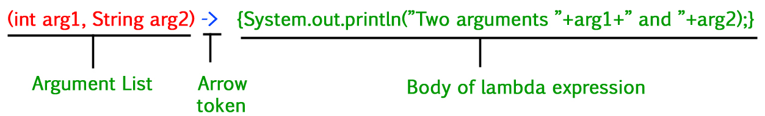
Java 8
For example, a Web browser can do several things at the same time:
Lambda Expression Syntax :
Lambda
Lambda Expression Syntax Parameters:
Zero Parameter :
() -> System.out.println("Zero parameter lambda");
Single Parameter:
(p) -> System.out.println("One parameter: " + p);
Multiple parameters
(p1, p2) -> System.out.println("Multiple parameters: " + p1 + ", " + p2);

Slide 5
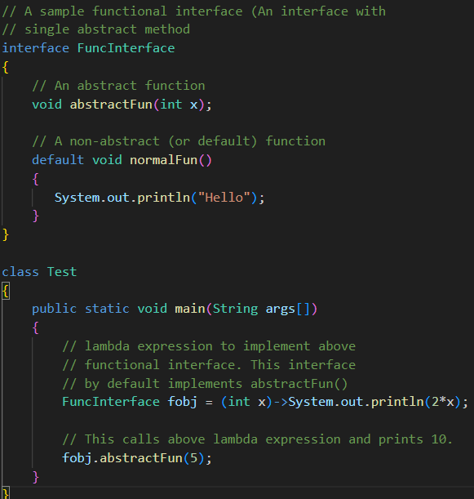
Java 8
Lambda

Slide 6
Java 8
Base64 is a binary-to-text encoding scheme that represents binary data in an ASCII string format.
Base64 is used to encode binary data, such as images, audio files, or any binary data, into a text-based format.
Base64 encoding is not a form of encryption; it's simply a way to represent binary data in a format that is safe for transportation in text-based protocols like
    email
    HTML
    XML documents
Base64 encoding uses a set of 64 characters :
  The 26 uppercase letters
  The 26 lowercase letters
  The 10 digits
  The '+’
  The '/' characters.
Base64

Slide 7
Java 8
Default methods provide a way to add new functionality to interfaces without forcing all classes that implement the interface to provide an implementation for the new methods.
A default method is defined using the default keyword followed by the method signature and implementation.
The implementation of the default method in the implemented classes is optional in General .
The implementation of the default method is mandatory just in case of class implements multiple interfaces that have default methods with the same signature .
Default Method

Slide 8
Java 8
Java 8 allows interfaces to have static methods with method bodies.
These static methods can be called directly on the interface, without the need for an implementing class.
Unlike abstract methods, static methods in interfaces can provide a default implementation.
If a class implementing the interface does not provide its own implementation, the default implementation in the interface is used.
Static Method

Slide 9
Java 8
Java 8 introduced several features and enhancements to support concurrent programming:
  Completable Future provide a more flexible and expressive way to work with asynchronous tasks and futures.
  Stream API allows for parallel processing of data.
  New Executors : includes a method newWorkStealingPool() which creates a work-stealing thread pool, which can be more efficient for certain types of parallel algorithms.
  Parallel Array Sorting:
  Includes a new parallel Sort() method, allowing arrays to be sorted in parallel, potentially providing performance benefits for large arrays.
Concurrent

Slide 10
Java 8
Optional class was introduced to provide a more robust way of handling situations where a value may or may not be present.
Optional is designed to address the problem of dealing with null values and to encourage better practices in handling the absence of a value (NullPointerException) .
Optional is an immutable object, and its methods do not modify the instance but instead return a new one.
Optional often used as a return type for methods to indicate that the result may or may not be present.
Optional

Slide 11
Java 8
Streams is a new abstraction introduced in Java 8 to express operations on data in a concise and functional manner.
Streams is a sequence of elements that can be processed in a functional style.
Streams allow for processing collections of data in a declarative way, similar to SQL queries.
Streams methods :
  Filter
  Map
  ForEach
  Collect
  Reduce
  Sorted
  Count
  Distinct
Streams

